Slide 1
SAP BTP Extension Suite Training
Day 4
Anubhav Oberoy
www.AnubhavTrainings.com
Follow excellence with sheer passion

Slide 2
Agenda – Day 4
01
Difference between Cloud and On-premise Solutions
04
Account overview and Setup your SAP BTP Account Trial / Services
02
05
Micro service architecture and First Micro service in SAP BTP
What is Cloud Foundry
03
Introduction to SAP BTP as a Solution & Architecture
06
Develop and deploy First Hello World App

Slide 3
Agenda – Day 4
07
10
Basics of JavaScript and NodeJS
Title
08
11
Title
Title
09
12
Title
Title

Slide 4
Authentication v/s Authorization
Authentication – It ensures that is our user a valid user? Has he/she entered valid credentials to login to our app. It is enforced by a login screen. This login screen can also come from IDP like SSO, LDAP, Social integration.
Authorization – Once user is authentication, then the authorization comes into play. It ensures, is our user allowed to do certain activities inside app. What is the level of access. E.g. create, update, delete, approve, view.
SAP BTP cf environment has a special component called XSUAA –
XS – eXtended Services
UAA – User Account and Authorization
This is an in-built component inside of CF
It is responsible to control the user account and authorization
It manages our application security
In CF we use modular approach to address security
As a developer we need to decide what roles and level of security we need in our app. Example, we need to secure odata resource /Anubhav.svc
Usually we define Viewer, Editor
We need to define our scope and role templates inside a special file called xs-security.json file
XSUAA Communicates to the IDP – Identity Provider
Issues JWT (JSON web Token) to cloud foundry router which let user access the app based on permission.
Scope
(Role)
* *
Role Template
* *
Role Collection

Slide 5

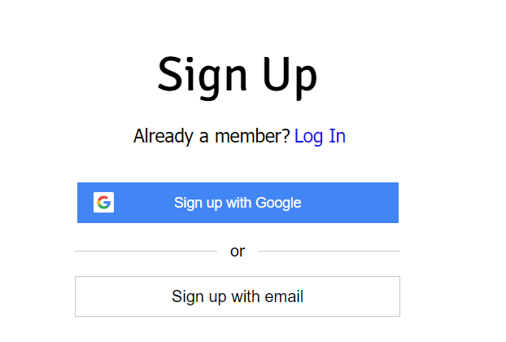

IDP – Identity Provider
An identity provider is a software or group of software which stores all the user credentials and their scopes (roles) in itself. This will centralize the user management in company and simplify the login process to different apps. This way user do not need to remember multiple passwords to multiple apps.
Portal
Launchpad
Dedicated SRM
SSO
SAP Server
GSuite
LDAP
User/email/password
Single source of truth
Trust relation
Scope- clerk, manager, ceo
Outlook
Our cloud app
xsuaa
XSUAA

Slide 6
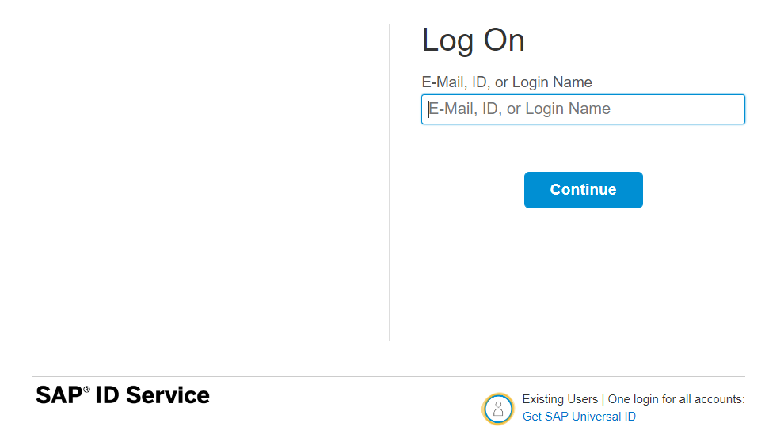
How it works behind scenes
xs-security.json contains information which we need to register to define what are all permissions required in our app
code
JWT
App
Browser
postman
ourxsuaa
trust
JWT
XSUAA
Scope
SAML
trust
IdP

Slide 7

Hands-on Add Security and Test Microservice
cds add xsuaa

Slide 8
Testing the Microservice from postman
After the deployment, we open the postman tool and try to access resource with URL /vendor url, it gives unauthenticated.
We need to obtain access token so we went to authorization table and added the OAuth2.0 option and provided
Properties | Value
Token Name | BTPJWTToken
Grant Type | Password credentials
Access Token URL | Service key of xsuaa – url, append /oauth/token
Client Id | Service key – client_id
Client Secret | Service key – client_secret
Username | Our BTP account user id
Password | Our BTP account password
3. Call get token and choose use token button once token was fetched.
4. Again make get request for /vendor, and we should get response.
5. If we try /vendor/, it will not work because, we are looking for Role.
6. Went to BTP subaccount and created a Role collection, added the role template and assign same to our user
7. Again get the token and try to access end point for OData, this time it works.

Slide 9
Challenges in Current Approach
Did you notice, that we need to first pass lots of technical details from service key
Pass all the info in correct manner to postman to obtain token
Once the token expired, we need to reobtain again and again
Our end user do not know all this. Automate the XSUAA JWT token processing.
In our app, we will have multiple microservices, like java, sap ui5, node app, xsuaa…
Each service produce one end point e.g. /vendors, /index.html, /customers, they all logically belongs to same app. Will you give 3 url to our user to access these apps?
These microservices also needs to communicate with each other. Provided we give a single end point to access our entire app to end user.
We want to complete redirect mechanism to let user go to login screen, authenticate on IDP and exchange of all the tokens should be seamless behind the scenes.
We need a single entry point for entire app, forwardAuth tokens should be done automatic.
url
Application router
(Provide single entry point, exchange auth token,
Communicate between microservices, like a facade)
xsuaa
Java
/Anubhav.svc
UI5 App
/index.html
Node
/customer

Slide 10
Introduction to App Router
It is a Node JS Application
It is used to automate the process of authentication, authorization with XSUAA to do token exchange
It sits in the middle of IDP and XSUAA, it will redirect the request to our microservice to xsuaa, and eventually to idp
IDP sends the login screen to the user, user authenticates, which is taken to XSUAA, XSUAA issues JWT Token, this JWT token is presented to api end points
App Router takes the JWT token from XSUAA and gives it to our microservices and even exchange this token to multiple microservices inside
It Serves as a single entry point for the entire app.
To tell app router about our multiple microservices so that it can re-direct, we need to create a configuration file named as xs-app.json which contains the details.

Slide 11



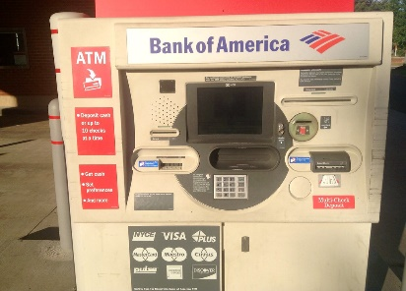
Real World Example
Customer
1
5
4
2
Loan
Credit Card
6
Validate, trust
Deposit
Draft/Cheque
3
FD
*******
7
Locker
This Photo by Unknown Author is licensed under CC BY

Slide 12
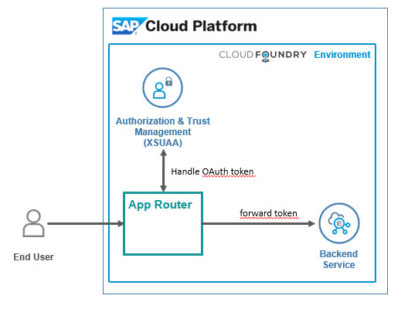
Hands on: App Router
Solution
https://github.com/soyuztechnologies/BTP_Architect_Training/blob/master/Day%203/04approuter.zip

Slide 13
Hands on : Deploy Application to BTP
First add the mta.yaml file, MTA – multi-target application which is an advance version of manifest.yml file which we used in past.
We use SAP provided CLI for MTA, this is pre-installed in BAS, tool is called mbt
First we run command cds add mta
We will add our UI module to the mta.yaml file manually, copy the srv entry and add the ui module.
- name: mycapapp-ui
type: nodejs
path: app
parameters:
buildpack: nodejs_buildpack
build-parameters:
builder: npm-ci
requires:
- name: srv-api
Inside the app folder, add the package json using npm init and add the app router module npm install @sap/approuter.
Add the start script "start": "node node_modules/@sap/approuter/approuter.js"
Add the xs-app.json, provide the routes and the end points
Open MTA editor and configure srv-api destination
Right click on mta.yaml file and choose build mta archieve this will create a mtar file for us

Slide 14
Adapt MTA.yml for UI deployment
Solution:

Slide 15
Hands on – Adding Security
Created a new resource in mta.yaml file for xs-uaa backing service with following properties
name == cappo-xsuaa
service == xsuaa
service-plan == application
path == ./xs-security.json
Add the dependency of this newly created xs-uaa service to our microservices in require section
Create the xs-security.json file from sap btp documentation and adapt file to have 2 roles – Viewer and the Admin role. The viewer role also have an attribute called bank name which will be for row level security.
Add 3 node modules which will help in security configuration for our app
npm install passport ; npm install @sap/xssec ; npm install @sap/xsenv
5. We need to inform app router to contact xsuaa to mandate the use of JWT token. In xs-app.json file
Change authenticationMethod : route and add "authenticationType": "xsuaa"
6. We need to secure our service resources to only allow authenticated user, hence we need to add an annotation requires: 'authenticated-user’
We need to tell system that if we run app locally (development environment) in BAS tool, use mock strategy for testing security. After deployment to CF (production environment) we use JWT strategy.

Slide 16
Security Profile
Additionally we configure demo local users for testing purpose. Under cds → requires section inside package.json file we add the strategy
"auth":{
"[production]":{
"strategy": "JWT"
},
"[development]":{
"strategy": "mock",
"users": {
}
}
}
8. Now we can test our app using cds watch --profile hybrid

Slide 17
What is Extensibility
Extensibility is a key capability of SAP ECC and SAP S/4HANA. It enables customers to create a competitive advantage by customizing their business processes and allows partners to enrich core ECC or S/4HANA with tailor-made solutions
During the last decades SAP’s on-premise customers and partners have mainly used classic ABAP extensibility to extend their ERP solution. Classic extensibility allows ABAP developers to use and even to modify all SAP objects. Although, classic extensibility is very powerful and flexible, it is no longer a good option in today’s cloud world.
In-lined with cloud strategy, SAP S/4HANA provides a new upgrade-stable cloud extensibility model that clearly separates SAP code and extensions via public SAP APIs and SAP extension points.

Slide 18
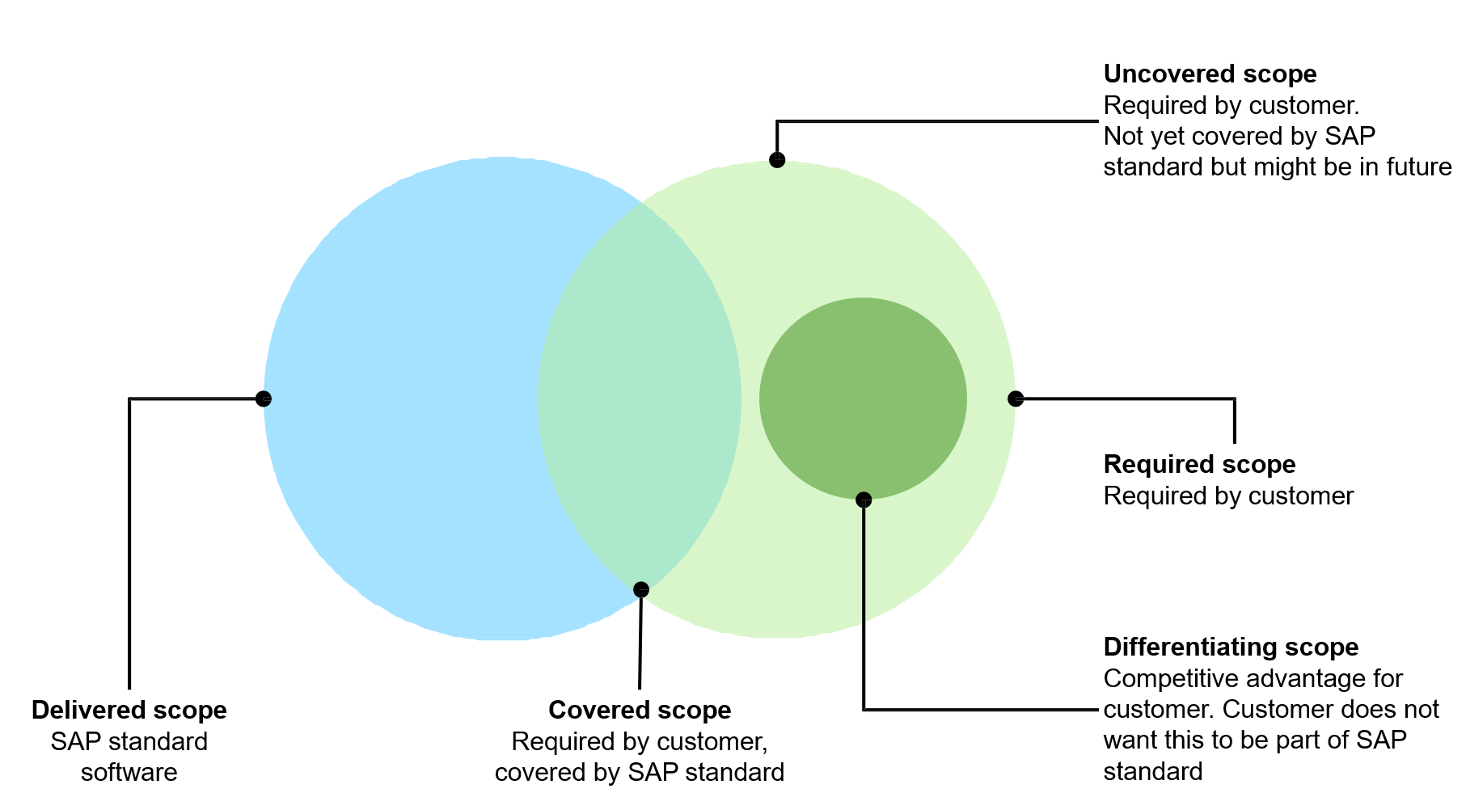
What is Extension?
We all know that standard SAP software doesn’t cover the scope of all the company business processes. There is always a need for a new app, a new report, or a new functionality. SAP partners and customers have been traditionally building extensions on SAP ECC system using ABAP code. However, with SAP S/4HANA and customer’s digital transformation journey towards cloud, we need a more robust yet loosely coupled extensibility model.

Slide 19
Classic Extensions and Challenges
Traditionally, SAP partners and customers have been using classic ABAP extensibility to extend their ERP solution.
Classic Extensibility (aka classic ABAP custom development) in SAP S/4HANA (or in SAP ECC):
Allows you to use classic development tools and techniques (e.g., transaction SE80, Eclipse IDE, BAdIs etc.)
Very rich of features and functions.
Extremely flexible and even allows you to modify SAP code itself.
Although, being very powerful, flexible, and popular, classic extensibility has some major drawbacks.
One of them is High Upgrade Efforts!
The missing clear interface between SAP code and extensions might lead to issues in the extensions during upgrades. As a result, upgrades require high planning, regression test, and adaption efforts, which is one of the reasons why customers delay upgrades.
Example:
You have used an SAP object that is not whitelisted by SAP in your extension. After an upgrade the used SAP Object has been changed or deleted. Now you will have to adjust the extension thus upgrade is delayed.

Slide 20
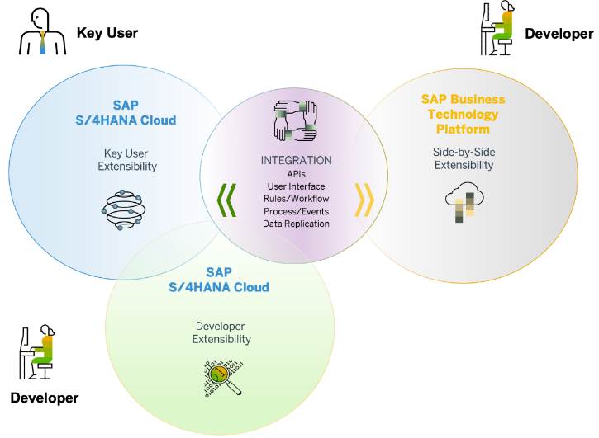
Clean Core and Benefits
Clean core is an extension methodology in which
Extensions are kept strictly separate from the SAP application.
Extensions access SAP business objects only through well defined, upgrade-stable interfaces
By following clean core paradigm, you make sure that
Extensions do not break an upgrade and upgrades do not break an extension.
Extensions do not create a problem when you migrate from SAP S/4HANA on-Premise to SAP S/4HANA Cloud
SAP’s rationale behind the “clean core” paradigm is simple – Allow customers to extend their SAP S/4HANA software while making the software updates eventually non-events.
Clean core paradigm is the back-bone of S/4HANA new extensibility model. It provides following benefits
Reduce TCO
Make upgrades non-events from a custom code point of view
Reduce test efforts for business users
Reduce adaption efforts for developers
IT service providers can offer upgrade projects at a fixed price
Speed and Innovation
Absorb innovation delivered by SAP at a faster rate
React fast on changing business requirements
Be cloud ready
Lay the foundation today to move to the cloud from a custom extension perspective

Slide 21
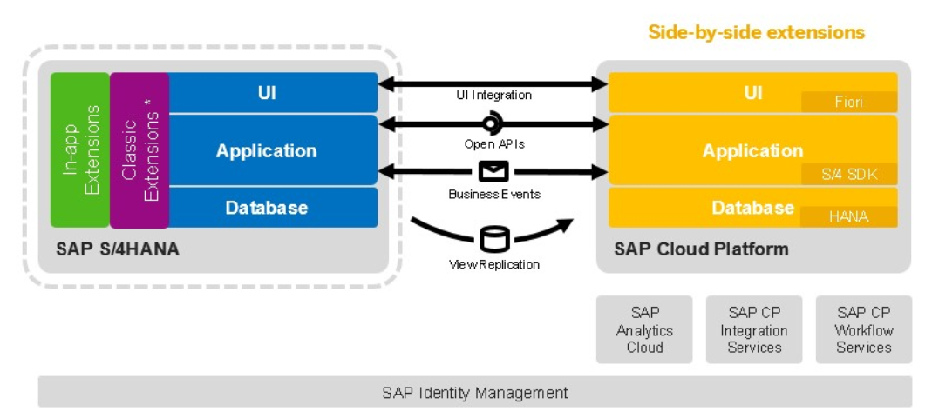
Approaches for Side-by-Side Extension

Slide 22
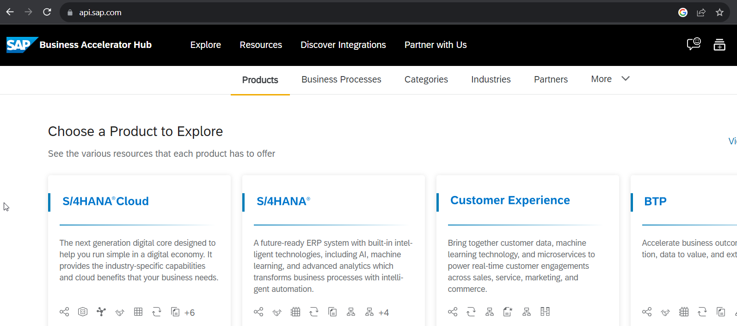
SAP Business API HUB
The SAP API Business Hub is a web application hosted by SAP to discover, explore, and test SAP and partner APIs (application programming interfaces). API’s enable to build extensions or process integrations.
Access
The SAP API Business Hub is a public website https://api.sap.com that anyone can access. You might however need to login to experience some of our features.
What are APIs?
An API is a programming object that enables developers to use or extend the provided functionality in a service. With API’s you can extend solutions, integrate them with other solutions, or build new apps.
Different API types
You will find REST, SOAP, and OData APIs on the SAP API Business Hub. A description for the different API types you can find here.

Slide 23
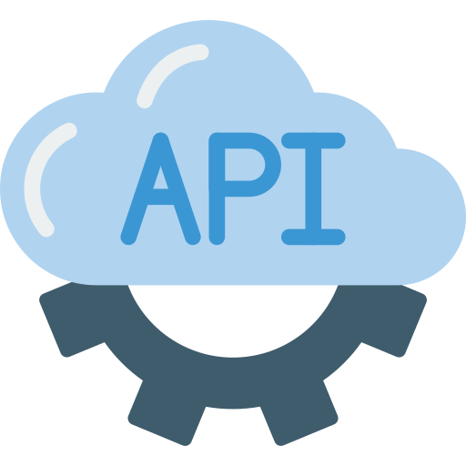
Hands-on : Find SAP Sales Order API in APIHUB & Test in POSTMAN

Slide 24
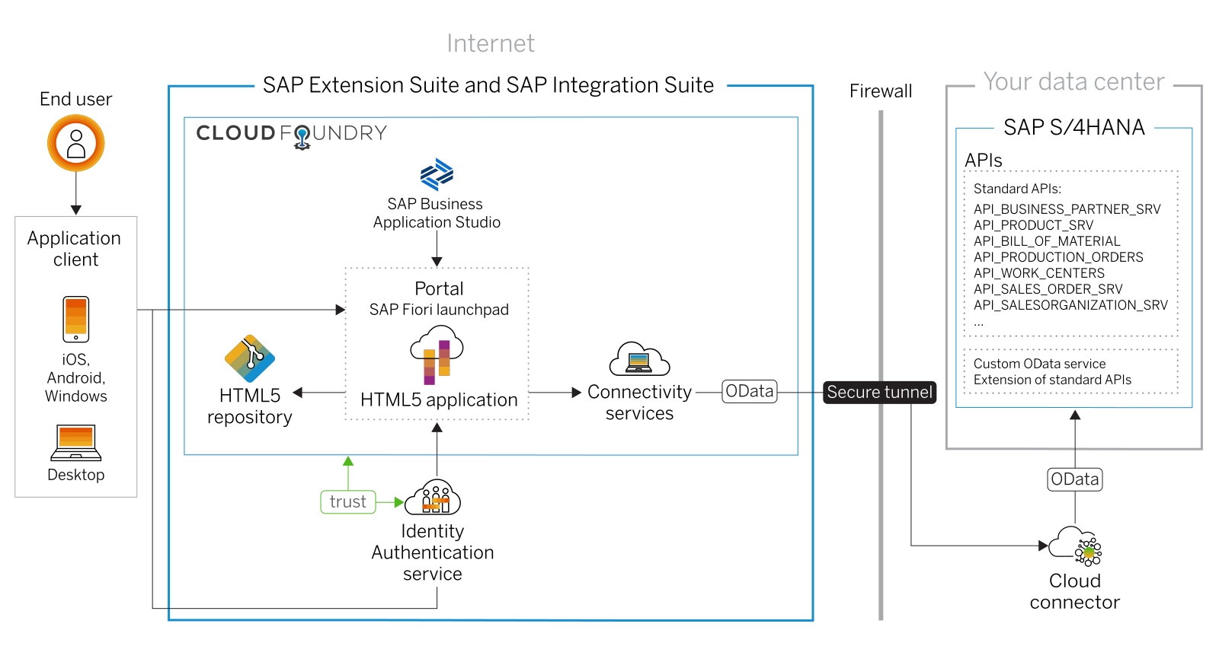
Scenario 1: UI Extensibility

Slide 25
Hands on: Create Display like App for Sales Order
Enabling an OData API on SAP S/4HANA
Setting up SAP Cloud Connector and S/4HANA for principal propagation
Setting up an SAP BTP BAS Subscription
Developing of a simple Fiori Application with the SAP Business Application Studio
Deploying the application to the HTLM5 repository service
Integrating he application into the Launchpad service
Destination service – to read the destination from SAP BTP at runtime for the purpose of connection
Connectivity service – once the destination is read, it will use connectivity service to connect to our oData source
HTML5 deployer – this will be used to deploy our app to HTML5 repository.
HTML5 Repo Runtime – Will load the Fiori app when requested at runtime.
Fiori launchpad service – which displays Fiori apps as a tile.

Slide 26
Scenario 2:
Own Fiori App
SAP or Non SAP API OData which we want to reuse
Android App
SAP UI5 App
CAPM App
Middleware
Data manipulation, enrichment, Security, automation, movement, proxy
HANA

Slide 27
Hands on: Initialize CAPM Extension
Create a new cap project with cds init
Drag drop edmx file downloaded from API hub and perform cds import PATH_OF_EDMX
Add a new CatalogService.cds and CatalogService.js
S4HANA cloud sdk is SAP’s portfolio of all the type safe API (node modules) to communicate to SAP APIs.
Install the node module @sap/cloud-sdk-vdm-sales-order-service
Add the configuration to test our api locally – credentials

Slide 28
Hands on: Initialize CAPM Extension
Create a new folder and initialize cap project using cds init
Go inside project and install following modules
2.1 Cloud Foundry Security - @sap/xssec, @sap/xsenv, passport
2.2 OData V2 @sap/cds-odata-v2-adapter-proxy
2.3 Serving odata v2 over cloud sdk - @sap-cloud-sdk/odata-v2
2.4 To generate the service code in node js, install cloud sdk generator module using @sap-cloud-sdk/generator
3. Create a new folder service-spec, and cds watch, after that drag drop the edmx file of our service to the folder. It will create external folder
4. Generate the JS code to automatically get all the calls which will call the service
npx generate-odata-client --input ./service-spec --outputDir ./srv/sales-order-api
Give the folder path, not the edmx file path
5. Define the service definition in CatalogService.cds file by referencing from csn file generated based on SAP OData
6. Define the service implementation CatalogService.js file and write the code to use the generated type script modules which will act like bridge to communicate to our SAP OData Business API.
7. Generate a Fiori application using free style with local cap project.

Slide 30
Hands on Cloud Extension
8. Replace hardcoded credentials with destination
9. Create a destination service and maintain destination with name S4HANA because the same we used in our code.
10. Create mta.yaml file for deployment
11. Add the modules, both srv and ui module.
12. Add Resources as destination and xsuaa. Maintain the xs-security.json file
13. Get the package json in app folder from ui project, Add the app router module @sap/approuter and include start script.
14. xs-app.json file for routing paths
15. Push the code to the github
16. You can pull the app in BAS tool, Right click on mta.yaml and build MTA Archieve
17. Once done, right click and deploy MTA_Archieve to SAP BTP

Slide 31
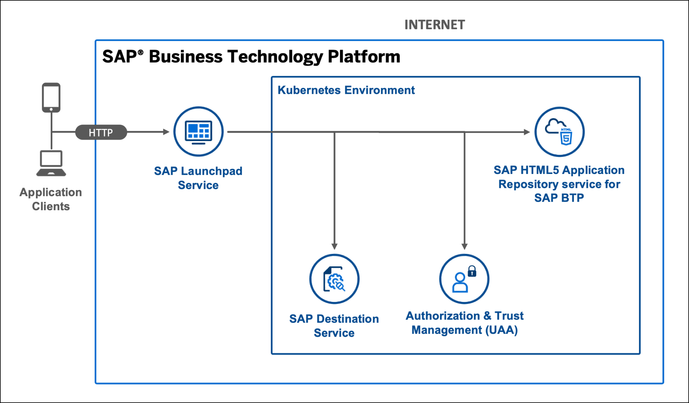
Hands on Serverless SAP Fiori Extension App

Slide 32
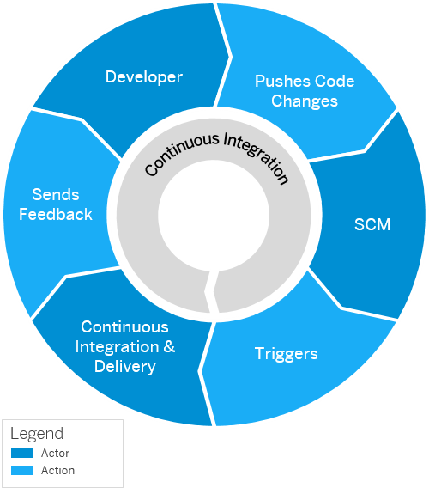
Continuous Integration and Delivery (CI/CD)
Configure and run predefined continuous integration and delivery (CI/CD) pipelines that automatically build, test, and deploy your code changes to speed up your development and delivery cycles.
Continuous integration (CI) describes a software development process, in which various team members integrate their contributions frequently into a single main line. Before each integration, the changes are verified through builds and automated testing. Thereby, you can detect errors as quickly as possible and prevent integration problems before completing the development.
The continuous delivery (CD) concept expands on the one of continuous integration. It adds the aspect that any change that has successfully passed the tests is immediately ready to be deployed to production, both from a technical and a qualitative point of view.

Slide 33
























CI/CD

Slide 34
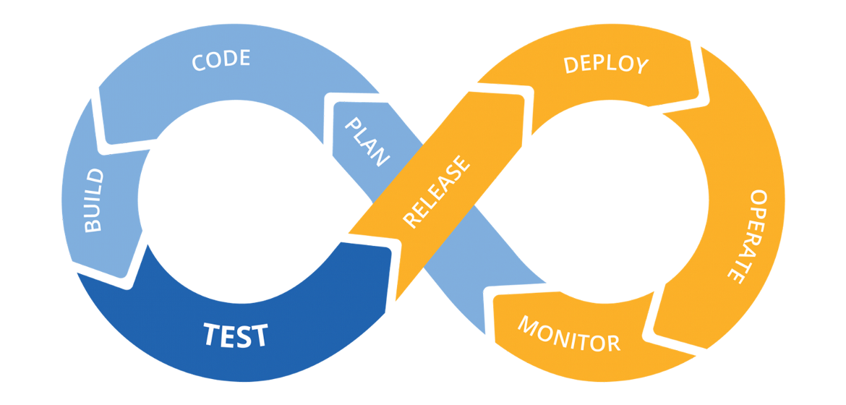
Hands on: Continuous Integration

Slide 35
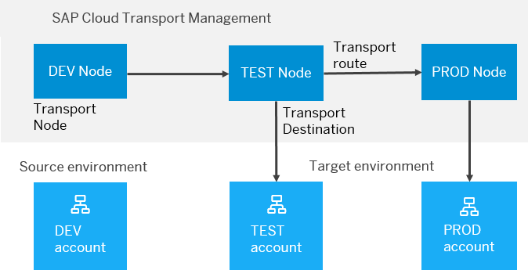
BTP Cloud Transport Management
SAP Cloud Transport Management service lets you manage software deliverables between accounts of different environments (such as Neo and Cloud Foundry), by transporting them across various runtimes. This includes application artifacts as well as their respective application-specific content.
SAP Cloud Transport Management service adds transparency to the audit trail of changes so that you get information about who performed which changes in your production environment, and when they did it. At the same time, the service enables a separation of concerns: For example, a developer of an application or of SAP Cloud content artifacts can trigger the transport of changes in a development subaccount, while the resulting import into the test, and production subaccount is handled by a central operations team.

Slide 36

Hands on SAP BTP Cloud Transport

Slide 37

What We Did
Let’s Summarize

Slide 38

www.anubhavtrainings.com
Thank You
End of Day 4

Slide 39



We’re committed to empower you to be
#FutureReady
through powerful training solutions.
We build the workforce of the future.
250+
Corporate Clients
30,000+
Learners Trained
25000+
Learners Placed
FREE WEBINARS
Sign up for free webinars with industry experts every fortnight!
Enroll Now!
Contact us today!
https://anubhavtrainings.com

